Slide 1
Lecture 14 Introduction to OpenCL
Kyu Ho Park
May 23, 2017
Ref:
1. David Kaeli et al. Heterogeneous Computing with OpenCL2.0, MK.
2.https://www.fixstars.com/en/openCL/Book/OpenCLProgrammingBook
3.OpenCl Introduction, PRACE/LinkSCEEM Winter School, CAPS

Slide 2
OpenCL
Motivation of OpenCL:
To standardize development platform for the fast growing parallel computing. It is to support heterogeneous computing environment with CPU and GPUs.
For shared memory type multiprocessor: openMP
It was initiated by Apple and managed by Khronos Group that manages the OpenGL standard.
OpenCL supports AMD/ATI, NVIDIA GPUs, X86 CPUS,DSPs, and FPGAs.
cuda – only supports nvidia

Slide 3
History of OpenCL and Multicore Processors
2001: IBM Power4 , the first multicore processor.
2005: AMD Athlon64, Intel Pentium D, the first multicore processors for desktop computers.
June 2008: OpenCL Working Group formed.
Dec. 2008: OpenCL ver.1
April. 2009: NVIDIA releases OpenCL SDK for NVIDIA graphics cards.
Aug. 2009:ATI(now AMD) OpenCL SDK for ATI graphics cards,
Apple OpenCL support for MacOs.
June 2010: OpenCL ver.1.1.
CUDA C introduced in 2007 by NVIDIA.

Slide 4
Data Parallelism Model
OpenCL Parallelism | CUDA Equivalent
Kernel | Kernel
Host Program | Host Program
NDRange(index space) | Grid
Work Group | Block
Work Item | Thread
NDRange: N Dimensional Range

Slide 5
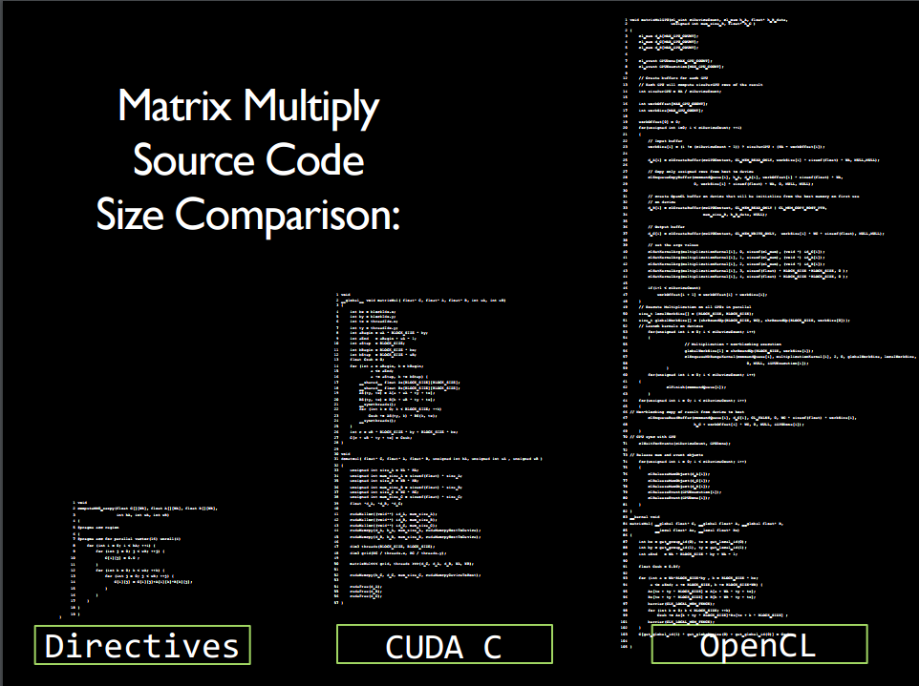
openAcc : simply transfer original source to parallel source (not optimization for architecture)
[Mathew Colgrove, Directive-based Accelerator Programming With OpenACC]

Slide 6
OpenCL execution
The host launch kernel functions as like the CUDA.
When a kernel function is launched , its code is run by work items.
A work item of the OpenCL corresponds to the thread of CUDA.
The work items are identified by global dimension index ranges(NDRanges).
Work items form work groups.

Slide 7
OpenCL Execution Model
Global Size(0)
Local Size(0)
(0,0) work group ID | (0,1) | (0,2) | (0,3) | (0,4)
(1,0) | (1,1)
(2,0)
(4,0) |  |  |  | (4,4)
Local Size( )
1
Global Size(1)
A work item

Slide 8
Indexing work items
In CUDA, the global index of a thread
= blockIdx.x*blockDim.x + threadIdx.x
In OpenCL, a work item can get its global index value by calling an API function
get_global_id().
get_global_id(0) returns the global thread index in the x dimension.
get_global_id(1) returns the id in the y dimension.

Slide 9
Indexing in OpenCL
To get the work item index in a work group,
get_local_id(0) which returns the local index of the work item within the work group in the x dimension.
: threadIdx.x in CUDA.
To get the size of a NDRange in the y dimension,
get_global_size(1).
: gridDim.y*blockDim.y
To get the size of each work group,
get_local_size(0).
: blockDim.x

Slide 10
Kernels and OpenCL Programming Model
Dimension of NDRange:
size_t indexSpace[3]={1024, 1,1};
Dimension of the work-group size:
size_t workgroupSize[3]={64, 1,1};

Slide 11
Platform Model
Platform model specifies one host and one or more devices. The devices execute OpenCL kernels.
Device 0
Compute Unit
Host
PE
PE
PE
…
Device 1,….

Slide 12
API for platform
clGetPlatformIDs( );
clGetDeviceIDs( );

Slide 13
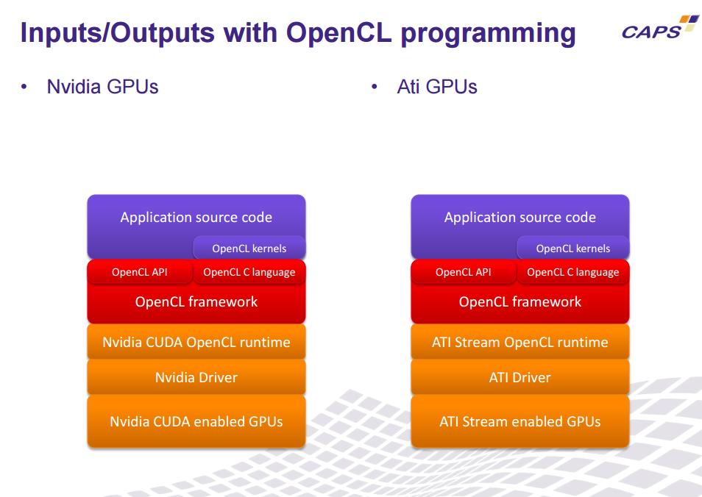
From [OpenCl Introduction, PRACE/LinkSCEEM Winter School, CAPS]

Slide 14
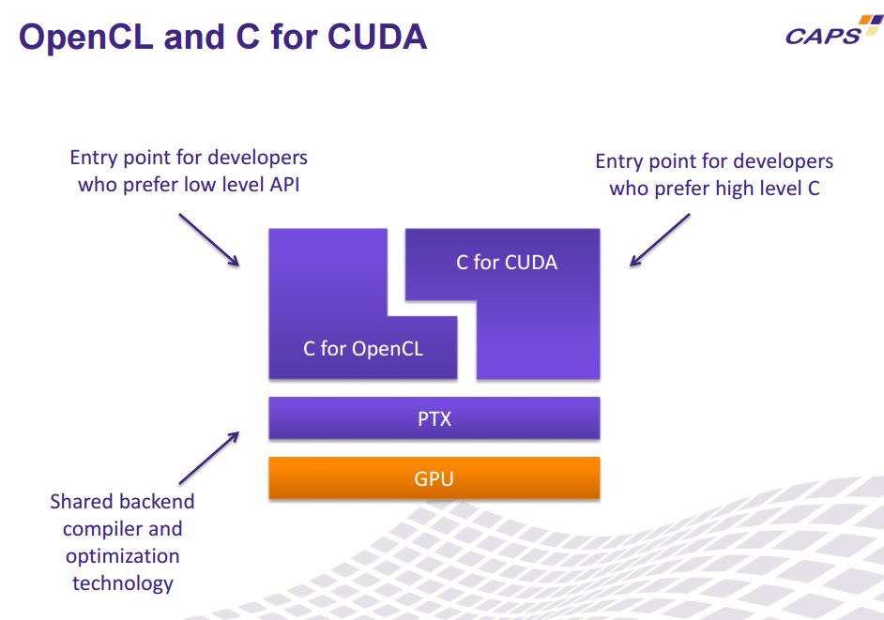
cause it should support various architecture
From [OpenCl Introduction, PRACE/LinkSCEEM Winter School, CAPS]

Slide 15
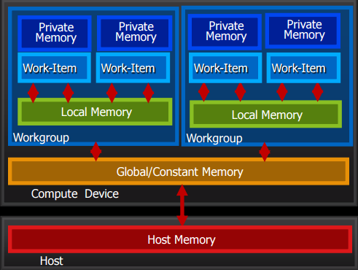
OpenCL Memory
From [OpenCl Introduction, PRACE/LinkSCEEM Winter School, CAPS]

Slide 16
Device Architecture
The Compute Unit can be CPU cores, DSPs, or FPGAs.
Each compute unit consists of one or more PEs, which corresponds to SPs in CUDA.

Slide 17
Memory Types
OpenCL CUDA
Global Memory Global Memory
__global
Constant Memory Constant Memory
__constant
Local Memory Shared Memory
__local
Private Memory Registers and
__private Local Memory

Slide 18
OpenCL Global Memory
OpenCL defines 3 types of global memory objects:
Buffers, images, and pipes.
Buffers:
Buffers are equivalent to arrays in C created using malloc(), where data elements are stored contiguously in memory.
cl_mem clCreateBuffer() allocates space for the buffer and returns a memory object. It is similar to malloc in C.

Slide 19
images
Image objects ,in the __global memory space,are treated differently from buffers.
Image objects can be 1D,2D or 3D and are specified using the image1d_t, image2d_t, or
image3d_t type qualifiers
It is an OpenCL memory object that abstract the storage of physical data to allow device-specific optimizations. It is to allow the hardware to take advantage of spatial locatlity.
cl_mem clCreateImage();

Slide 20
Pipes
Pipe:
It is for an ordered sequence of data that are stored on the basis of FIFO.
cl_mem clCreatePipe();

Slide 21
Kernel Functions
OpenCL kernel:
__kernel function( ) {…..}
CUDA kernel:
__global__ function( ) { …}

Slide 22
Kernel Example
//C language
void c_mul(int n, float *A, float *B, float *C)
{
for( int i=0;i<n; i++) C[i]=A[i] *B[i];
}
//OpenCL
__kernel void cl_mul(__global float *A, __global float *B, __global float *C)
{
int id=get_global_id(0);
C[id]=A[id]*B[id];
}

Slide 23
Creating a kernel
1.The source code of a program is turned into a program objects by the API,
clCreateProgramWithSource();
2.Compile it,
clBuildProgram();
3.Kernel created,
cl_kernel clCreateKernel( cl_program program,
const char *kernel_name, cl_int *errcode_ret);
4.Set kernel arguments,
cl_int clSetKernelArg( cl_kernel kernel,cl_uint arg_index,
size_t arg_size, const void *arg_value);
5. Execute a kernel on a device,
cl_int clEnqueueNDRangeKernel();

Slide 24
Execution Model
In order to execute a kernel on a device, a context must be configured. That enables the host to pass commands and data to the device.
Context:
A context is an abstract environment within which coordination and memory management for kernel execution is well defined.

Slide 25
OpenCL Context
To execute an openCL prgram we need,
A context
A program
A kernel
A command Queues
A buffer
Write to Buffer
Execute Kernel
Read from Buffer
Release resources

Slide 26
Context
Command Queue
Program
Kernel
Kernel
Device
Device
Device
Buffer
Device Buffer
Device Buffer

Slide 27
API to create a context
cl_context
clCreateContext(
const cl_context_properties *properties,
cl_uint num_devices,
const cl_device_id *devices,
void (CL_CALLBACK *pfn_notify)(
const char *errinfo,
const void *private_info,size_t cb,
void *user_data),
void *user_data,
cl_int *errcode_ret); or
clCreateContextFromType();//to create a context that automatically includes all devices of the specified type(CPUs,GPUs and all devices).
To query information of a system
clGetContextInfo( );

Slide 28
Command Queues
The execution model specifies that devices perform tasks based on commands which are sent from the host to the device.
Commands:
Executing kernels, data transfers and synchronization.
Command queue:
The host uses to request action by a device.
When the host decided to work with a device, one command queue should be created per device.
Command-queue creation:
cl_command_queue
clCreateCommandQueueWithProperties(cl_context context, cl_device_id device,cl_command_queue_properties properties,cl_int * errcode_ret);

Slide 29
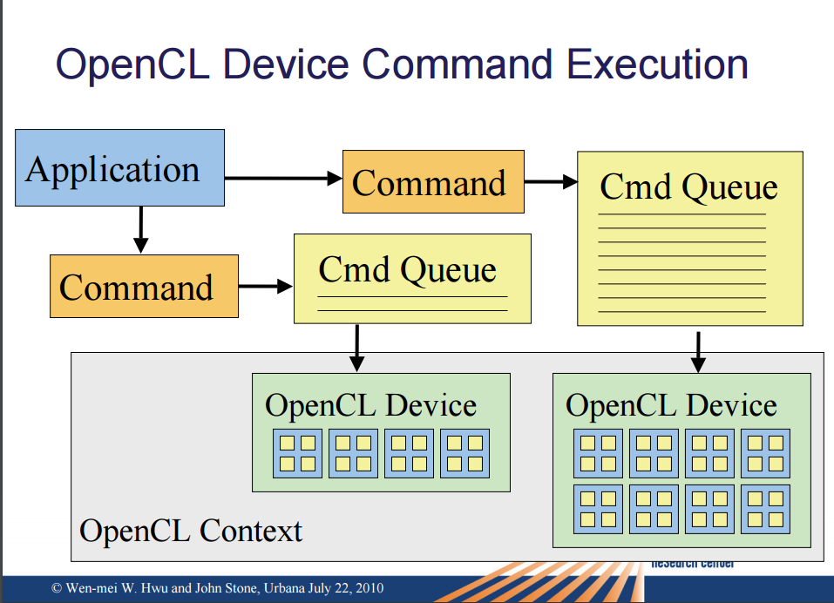

Slide 30
Copy HtoD and DtoH
Request the device to send data to the host:
clEnqueueReadBuffer();
Request that a kernel is executed on the device:
clEnqueueNDRangeKernel();
Barrier Operations:
cl_int clFlush(cl_command_queue command_queue);
//Issues all previously queued OpenCL commands in a command-queue to the device associated with the //command-queue.
cl_int clFinish(cl_command_queue command_queue);
//Blocks until all previously queued OpenCL commands in a command-queue are issued to the associated //device and have completed.

Slide 31
Kernels and OpenCL Programming Model
void c_mul(int n, float *A, float *B, float *C)
{
for( int i=0;i<n; i++) C[i]=A[i] *B[i];
}
__kernel void cl_mul(__global float *A, __global float *B, __global float *C)
{
int id=get_global_id(0);
C[id]=A[id]*B[id];
}

Slide 32
Procedure to execute an OpenCL program
1.Discovering the platform and devices
2.Creating a context
3.Creating a command-queue per device
4.Creating memory objects(buffers) to hold data
5.Copying the input data onto device
6.Creating and compiling a program from the OpenCL source code
7.Extracting the kernel from the program
8.Executing the kernel
9.Copying output data back to the host
10.Releasing the OpenCl resources.

Slide 33
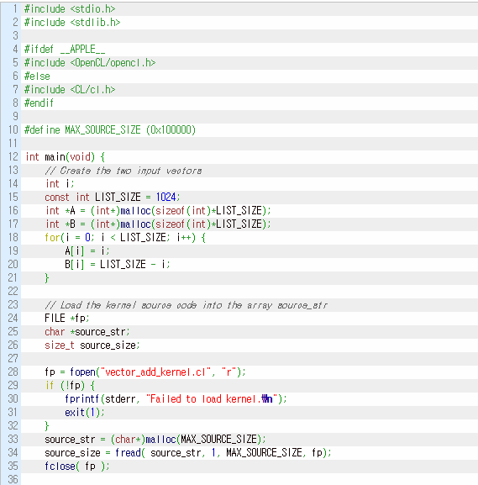
Initialization
[https://www.fixstars.com/en/openCL/Book/OpenCLProgrammingBook]

Slide 34
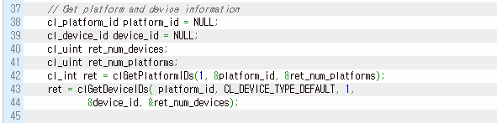
Discovering the platform and devices
[3.https://www.fixstars.com/en/openCL/Book/OpenCLProgrammingBook]

Slide 35
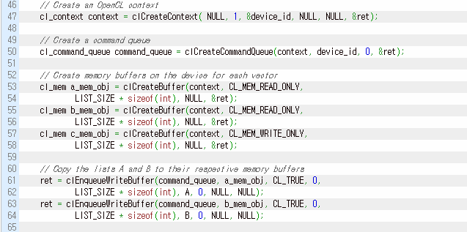
Creating a context and a command-queue
[3.https://www.fixstars.com/en/openCL/Book/OpenCLProgrammingBook]

Slide 36
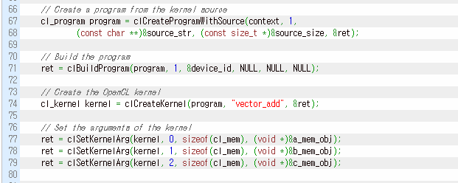
Build a kernel
[3.https://www.fixstars.com/en/openCL/Book/OpenCLProgrammingBook]

Slide 37
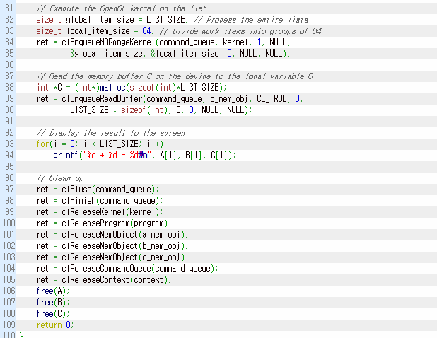
Execute the kernel and Releasing

Slide 38
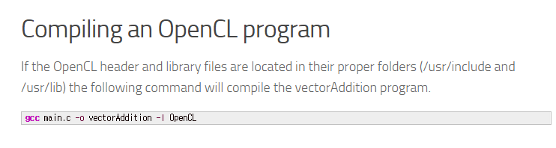
Compiling an OpenCL Program

